Slide 1
Beautiful-Marillion
By: Bronwyn Simmers

Slide 2
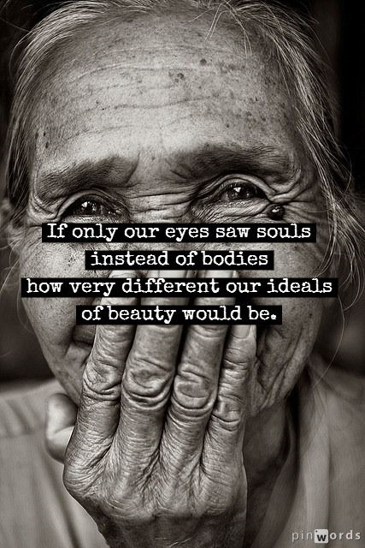
Everybody knows we live in a world Where they give bad names to beautiful things Everybody knows we live in a world Where we don't give beautiful things a second glance Heaven only knows we live in a world Where what we call beautiful is just something on sale People laughing behind their hands As the fragile and the sensitive are given no chance

Slide 3
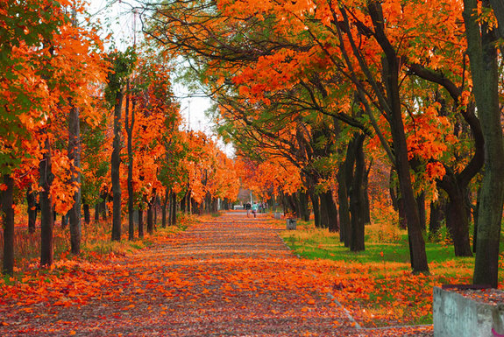
And the leaves turn from red to brown To be trodden down To be trodden down And the leaves turn from red to brown Fall to the ground Fall to the ground

Slide 4
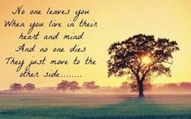
We don't have to live in a world Where we give bad names to beautiful things We should live in a beautiful world We should give beautiful a second chance

Slide 5
And the leaves fall from red to brown To be trodden down Trodden down And the leaves turn green to red to brown Fall to the ground And get kicked around

Slide 6
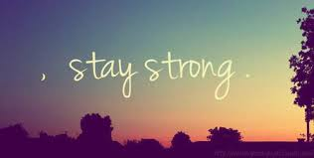
You strong enough to be Have you the courage to be Have you the faith to be Honest enough to stay Don't have to be the same Don't have to be this way C'mon and sign your name You wild enough to remain beautiful? Beautiful

Slide 7
And the leaves turn from red to brown To be trodden down Trodden down And we fall green to red to brown Fall to the ground But we can turn it around

Slide 8
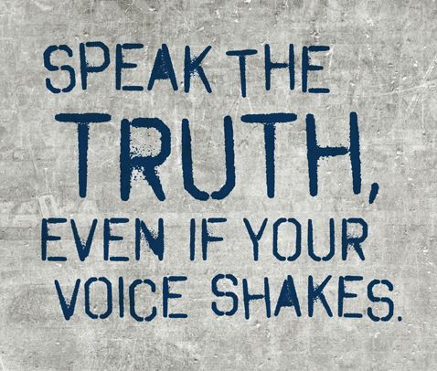
You strong enough to be Why don't you stand up and say Give yourself a break They'll laugh at you anyway So why don't you stand up and be Beautiful

Slide 9
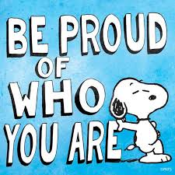
Black, white, red, gold, and brown We're stuck in this world Nowhere to go Turnin' around What are you so afraid of? Show us what you're made of Be yourself and be beautiful Beautiful

Slide 10
Analysis
The relation to the trees and leaves in this song is about how people are considered beautiful until something is revealed about them or until they open up a little.
Most people will look at someone as beautiful on the outside based on beauty standards that we have. When something is uncovered or shed, like the leaves of a tree, they are no longer considered beautiful.
Then it says to go against these beauty standards because it doesn’t matter what other people think and you shouldn’t be afraid or upset about it.

Slide 11
Relation to Society
As a society, we are quick to judge others based on appearance. We generally don’t take the time to get to know someone, we just stereotype them.
We have standards for how each person should look or act and if a person does not fit within those standards, it’s seen as a bad thing.
We put a lot of pressure on people to fit in these standards.

