Slide 1
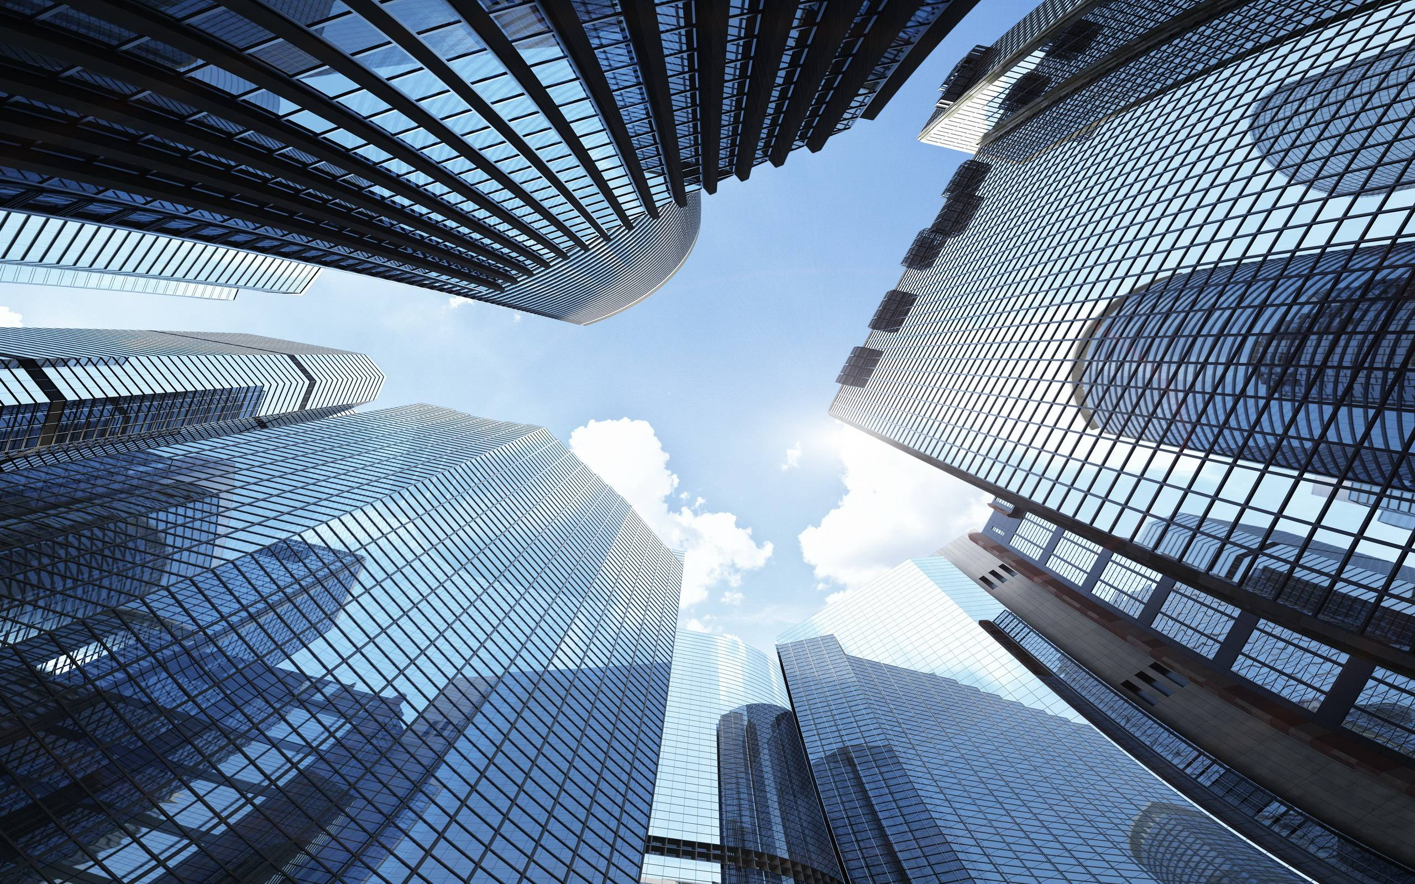
Skyscraper-demi lovato
By: Bronwyn Simmers

Slide 2
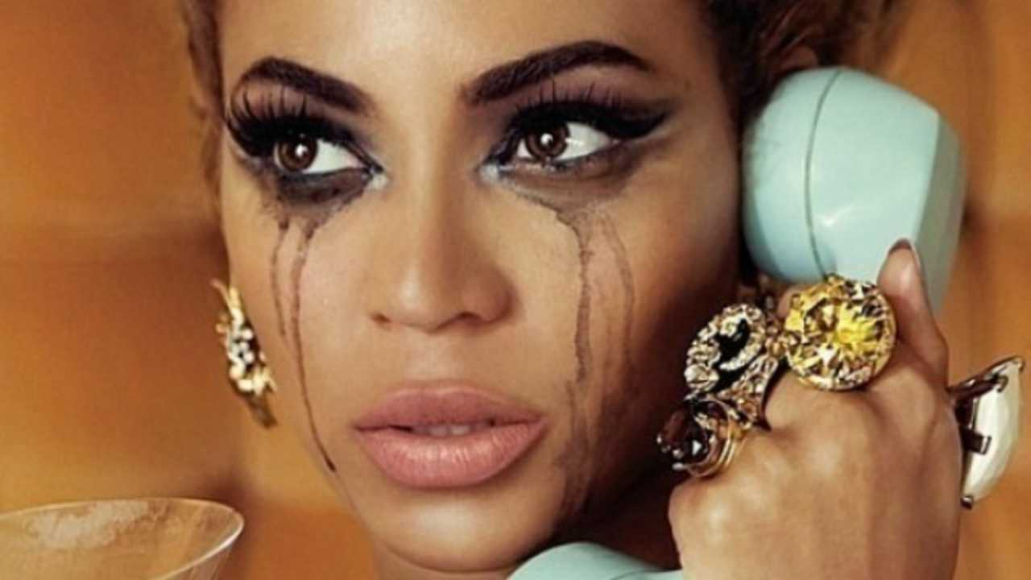
Skies are crying I am watching Catching teardrops in my hands Only silence, as it's ending, like we never had a chance Do you have to, make me feel like there's nothing left of me?

Slide 3
Analysis
The “skies are crying” at the beginning of the song is personification and it adds to the effect of the song. This is about someone who is crying over a relationship coming to an end and they are upset about that. It is like the other person in the relationship does not care anymore and they are making it seem as if the person meant nothing to them.

Slide 4
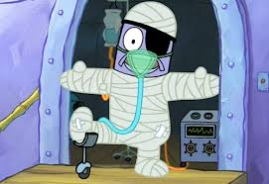
You can take everything I have You can break everything I am Like I'm made of glass Like I'm made of paper
Go on and try to tear me down I will be rising from the ground Like a skyscraper Like a skyscraper

Slide 5
Analysis
In this, the person is saying that, at this point, anyone could try their best to hurt them, but it will no longer work. They are too hurt and tired of caring what people think of them all the time. No matter what happens, and how fragile they may be, they will rise above it all and become a stronger person because of it.

Slide 6
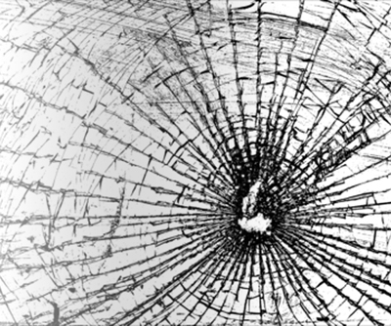
As the smoke clears I awaken, and untangle you from me Would it make you, feel better to watch me while I bleed? All my windows, still are broken But I'm standing on my feet

Slide 7
analysis
After everything has cleared and they can see what was really happening, they are able to get away from all the bad things that were happening in the relationship. Despite the other person who enjoys the fact they are struggling to get back on their feet, they will get up and persevere. They will fight to the end even if they are damaged and bruised.

Slide 8
Repeat Chorus

Slide 9
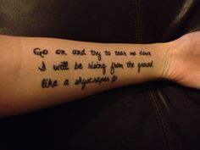
Go run, run, run I'm gonna stay right here Watch you disappear, yeah Go run, run, run Yeah it's a long way down But I am closer to the clouds up here

Slide 10
analysis
They are not afraid to leave the other person and keep climbing. Even though they could fall just as easily again, they will keep going up and living the life they want.

Slide 11
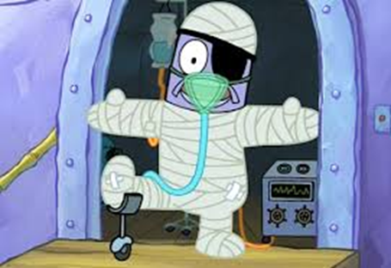
You can take everything I have You can break everything I am Like I'm made of glass Like I'm made of paper, Ohhh woaah Go on and try to tear me down I will be rising from the ground
Like a skyscraper

